Slide 1

Center for VLSI and Embedded Systems Technology (CVEST)

Slide 2
Research Areas
VLSI
Digital, Mixed Signal, Analog
Embedded Systems
Biomedical, DSP, Communications
Internet of Things (IoT)
Applications of IoT in industry, agriculture and home automation
Radio Frequency and Integrated Photonics
Hardware Software Co-design
Wearable Electronics
Healthcare
Flexible and stretchable sensor systems

Slide 3
Faculty Members
Dr. Syed Azeemuddin (head)
Dr. Zia Abbas
Dr. Aftab Hussain
Dr. Abhishek Srivastava
Dr. Anshu Sarje
Affiliations:
Dr. Suresh Purini
Prof. K. R. Sarma

Slide 4
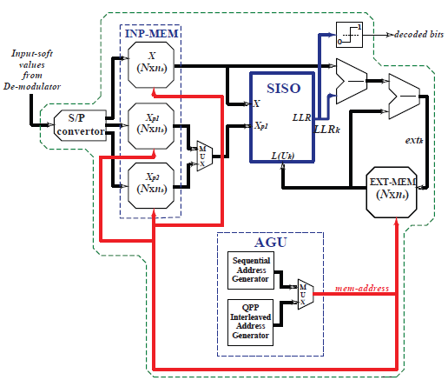
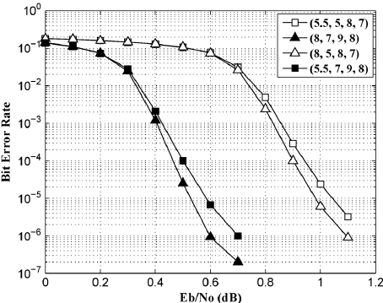
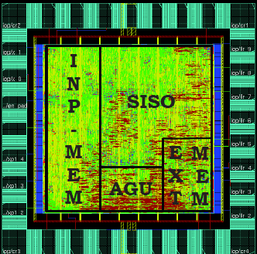
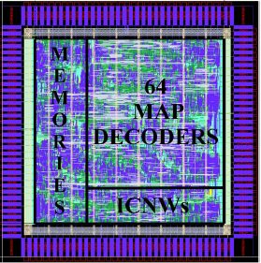
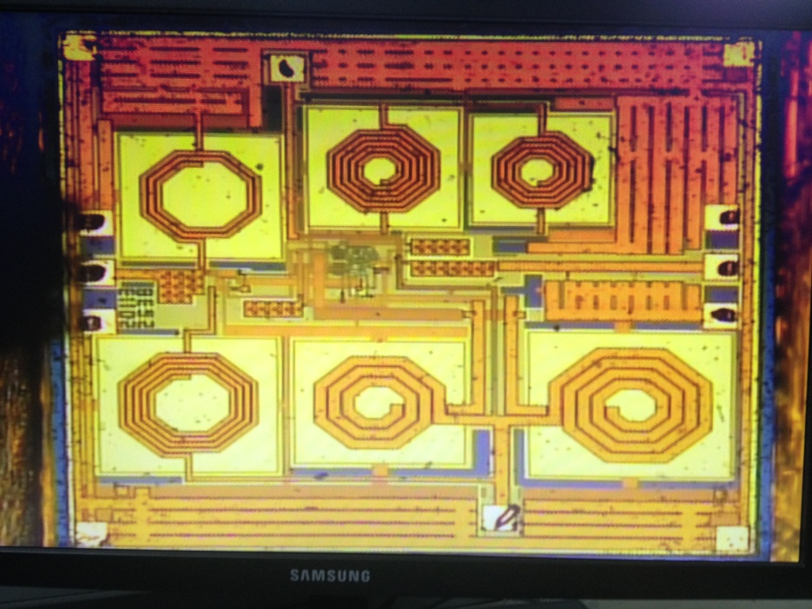
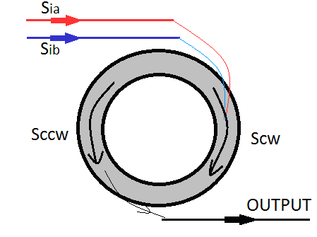
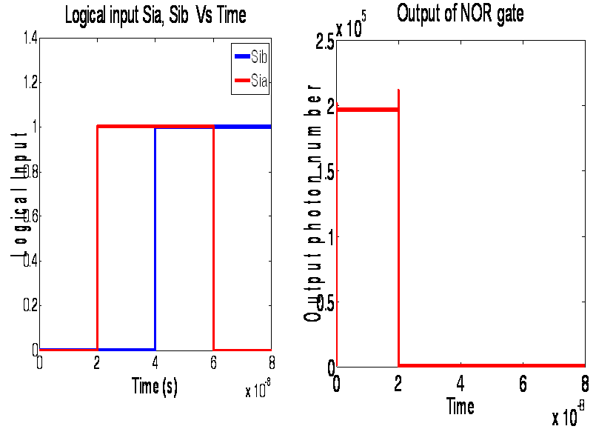
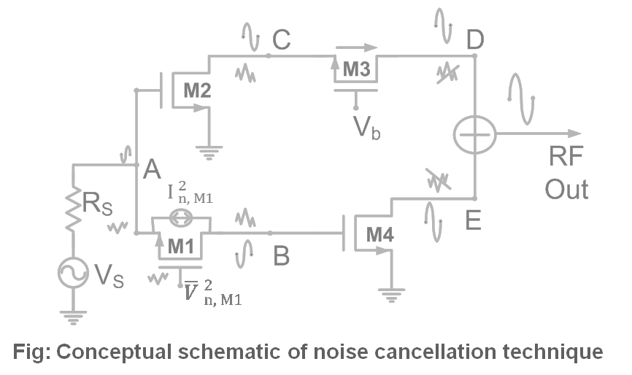
Dr. Syed Azeemuddin
Broad area:
RFIC design integrated RF devices incorporated with patterned ferromagnetic materials, micro/nano electronics and integrated photonics, optical devices using ring lasers
ASIC implementation of non-parallel radix-2 turbo decoder using 130 nm CMOS process.
Energy Efficient & High-Throughput Parallel Turbo Decoder
Noise Cancelling Topologies in UWB LNAs
All Optical Digital Gate

Slide 5
Dr. Zia Abbas
Energy-efficient/Low power VLSI design
ML driven self-adaptive VLSI Circuits
High Yield VLSI designs
Subjected to Process, Voltage, Temp, Aging (PVTA) variations
Using optimization algorithms
Robust transistor sizing
Artificial Intelligence driven surrogate models for nanoscale CMOS/FinFET based VLSI circuits
Analog/Digital Circuit design
RF Circuit design

Slide 6
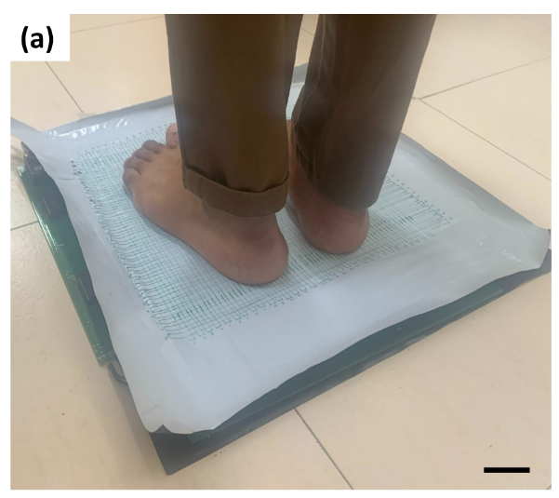
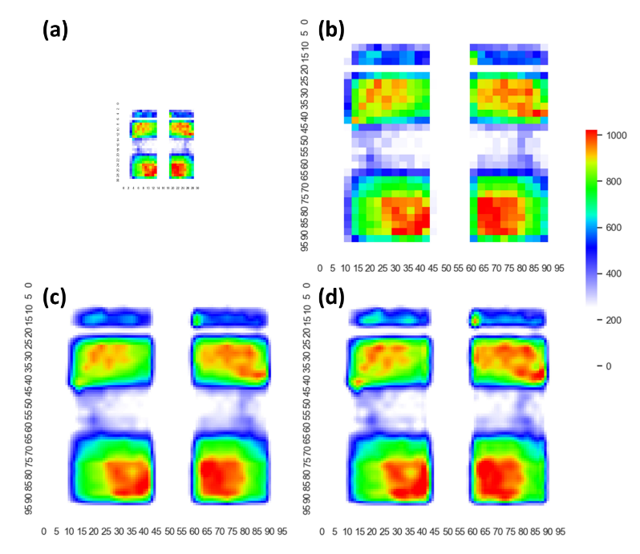
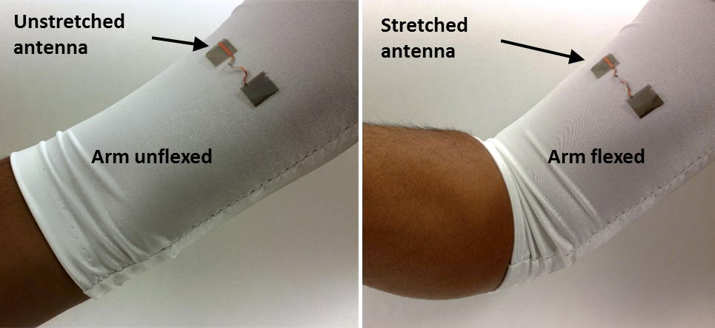

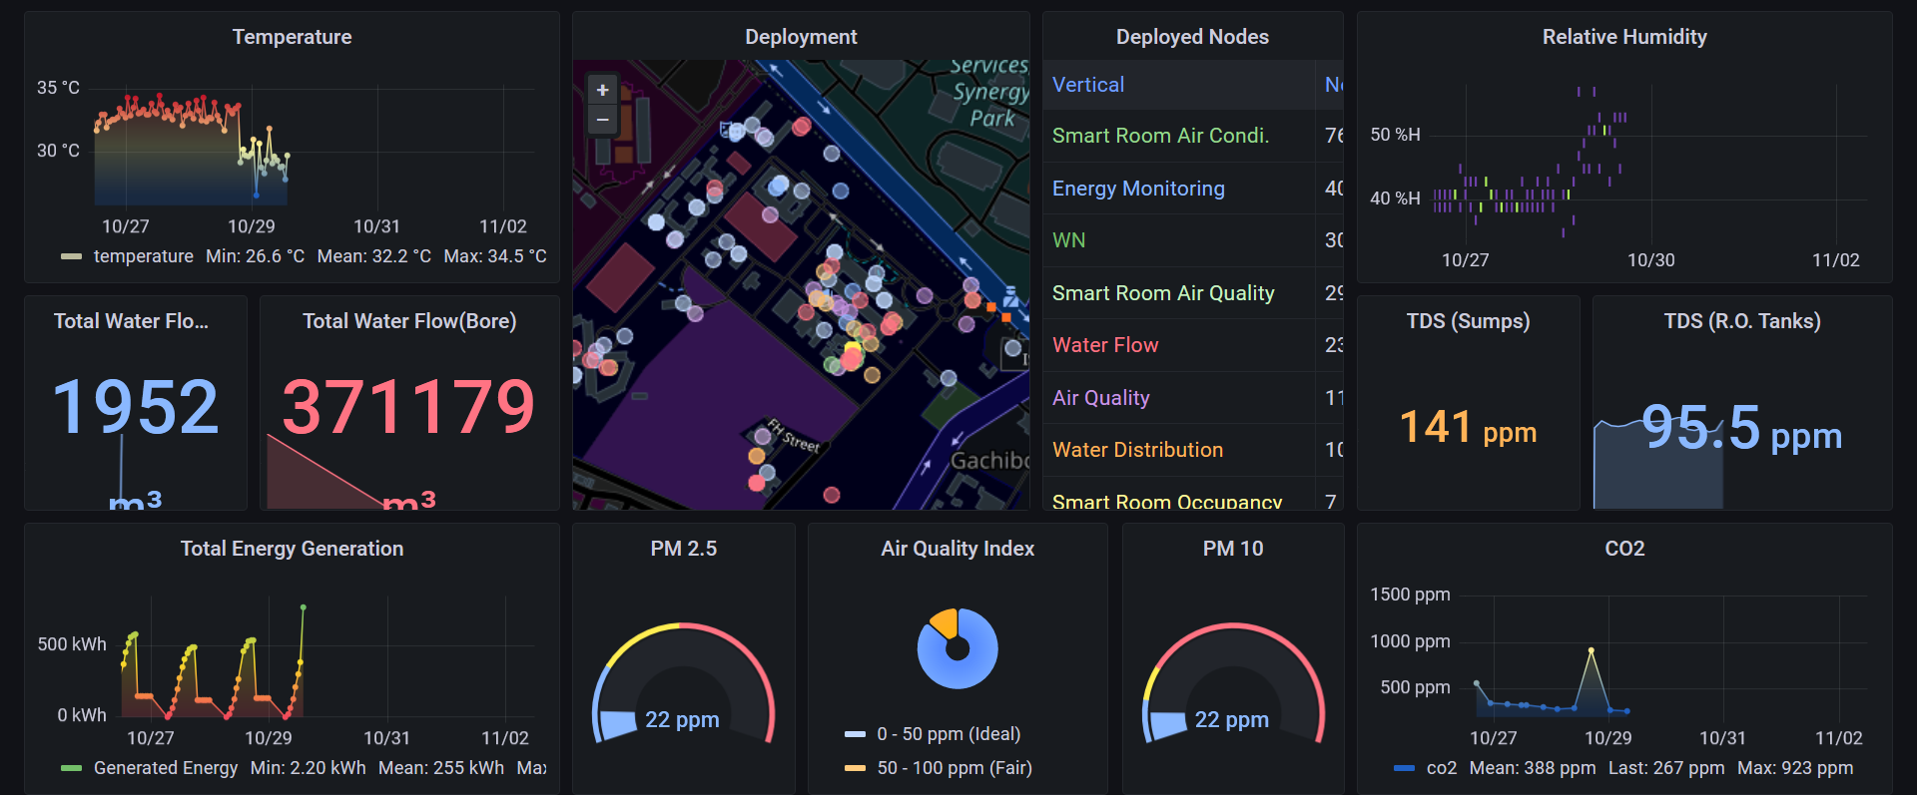

Dr. Aftab Hussain
Broad area:
Application of IoT in industry, agriculture and home automation
Flexible and stretchable sensor systems
Flexible sensor systems
Stretchable and wearable devices
Smart city research (IoT applications/Smart devices/Novel Communication systems)

Slide 7
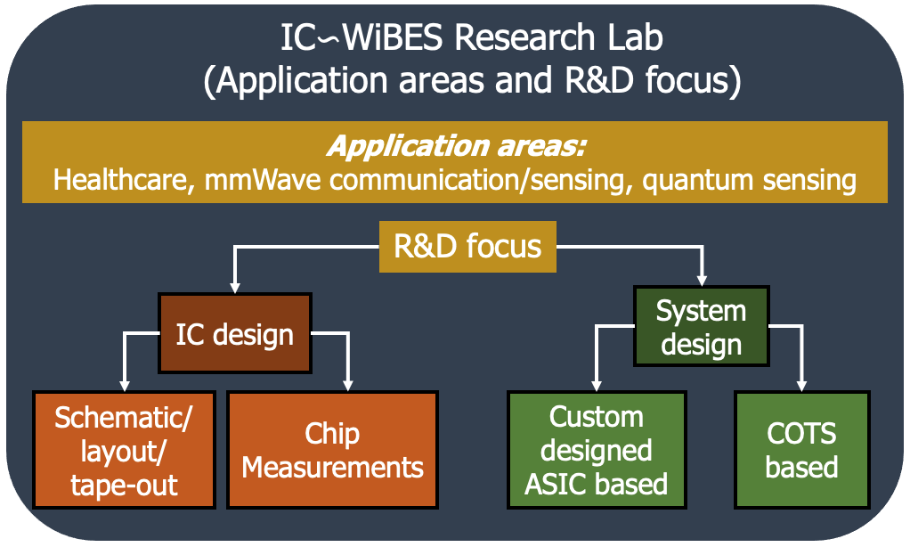
Prof. Abhishek Srivastava
https://fac-webpages.iiit.ac.in/abhishek/
Requirements
Basic circuit analysis (KCL/KVL/two-port)
Basic analog concepts
Basic understanding of MOS circuits
Willingness to learn new things
Perseverance
Honesty
Self-motivation
Design/layout/simulation of different integrated circuit building blocks (Analog/RF/Digital/VLSI)
To design, layout and simulate different circuit building blocks in Cadence. Opportunities to do tape-out and measure the designed ICs.
Example: digital scan-chain (flip-flops/shift-registers), amplifiers (low noise), oscillators, PLLs, voltage/current references)
System design (Embedded/IoT)
To develop systems by integrating sensors, commercially available hardware modules and micro-controllers
Example: Health monitoring applications, wireless sensing applications, worker safety applications

Slide 8
CVEST Research Results
Publications in Conferences and Journals
ISCAS, VLSI Design, EuMW, OSA, AIP, ISVLSI, VLSI-SoC
IEEE, Wiley, Elsevier, Springer
Grants Received
DST, DRDO, MHRD, Industries
Joint work
IITG, IITK, IISc, IITKGP, IITH, INRIA, UoM Gottingen, Intel, Austria MicroSystems
Placements
Qualcomm, Nvidia, TI, Samsung Semiconductor Research, MediaTek etc…

